Slide 1
Supported by
Indian National Committee
World Mining Congress
Ministry of Coal
Government of India
1st National Coal Conclave & Exhibition
17 OCTOBER 2022, HOTEL TAJ PALACE , NEW DELHI
Theme : Indian Coal Sector – Sustainable Mining towards Atmanirbhar Bharat

Slide 2
1st National Coal Conclave & Exhibition
17 OCTOBER 2022 (SUN
HOTEL TAJ PALACE , NEW DELHI
INAUGURAL SESSION
Welcome Address by Shri Vinod Kumar Tiwari, Additional Secretary Coa
Theme of Conference by Dr Anil Kumar Jain, Secretary Coal
Launch of Closed / Discontinued Mines of CIL on Revenue sharing model – Trance II Tender (online by Shri Pralhad Joshi, Hon’ble Minister for Coal, Mines and Parliamentary Affairs)
Address by Chief Guest by Hon'ble Minister Shri Pralhad Joshi, Hon’ble Minister for Coal, Mines and Parliamentary Affairs
Handing over of Vesting orders Shri Shri M Nagaraju, AS MN
Vote of Thanks by Shri Pramod Agrawal Chairman, CIL

Slide 3
1st National Coal Conclave & Exhibition
17 OCTOBER 2022
HOTEL TAJ PALACE , NEW DELHI
VALEDICTORY SESSION
Brief Report on Conference by Shri M Nagaraju, Additional Secretary, Ministry of Coal
Concluding Remarks & Way Ahead by Dr Anil Kumar Jain, Secretary, Ministry of Coal
Address by Chief Guest by Hon'ble Minister Shri Pralhad Joshi, Hon’ble Minister for Coal, Mines and Parliamentary Affairs
Vote of Thanks by Shri Vinod Kumar Tiwari, Additional Secretary, Ministry of Coal

Slide 4
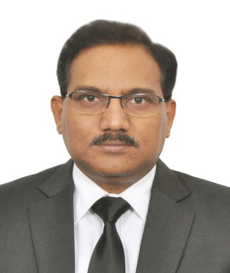
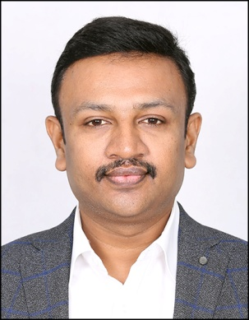
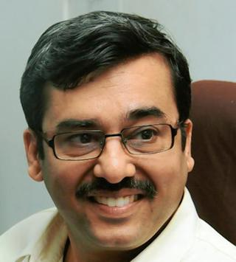
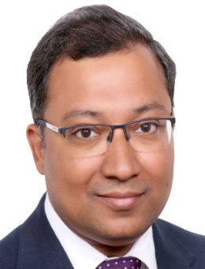
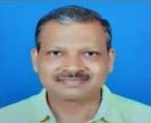
Supported by
Ministry of Coal
Government of India
Indian National Committee
World Mining Congress
SESSION I : FUEL SELF-SUFFICIENCY IN POWER SECTOR
Session Chairs
Speakers
V K DEWANGAN
Chairman
REC
N SRIDHAR
CMD
SCCL.
RAKESH LAKHONI
CMD
TANGEDCO
VIBHAV AGARWAL
CEO Power
VEDANTA
K C MURALEEDHARAN
GM
NTPC
1st National Coal Conclave &
Exhibition
17 OCTOBER 2022, HOTEL TAJ PALACE , NEW DELHI

Slide 5
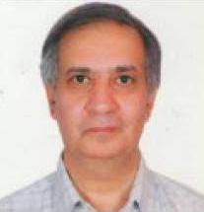
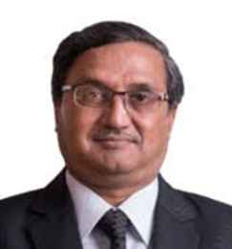
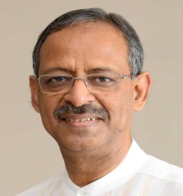
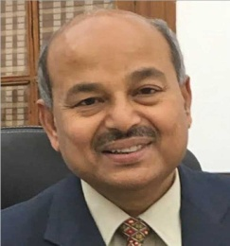
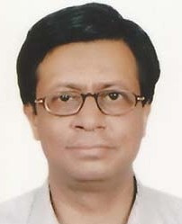
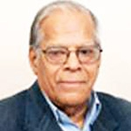
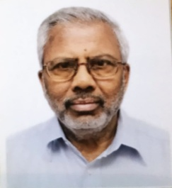
Supported by
Indian National Committee
World Mining Congress
Ministry of Coal
Government of India
BRAIN STORMING SESSION: ROLE OF COAL IN ATMANIRBHARTA
11.30 AM, VIP LOUNGE, SHAHJAHAN HALL
ALOK PERTI
S K SRIVASTAVA
ANIL SWARUP
SUSHEEL KUMAR
SUMANTA CHAUDHRI
DR. M P NARAYANAN
B AKALA
Moderator
and other Former CMDs of Coal Companies….
1st National Coal Conclave &
Exhibition
17 OCTOBER 2022, HOTEL TAJ PALACE , NEW DELHI

Slide 6
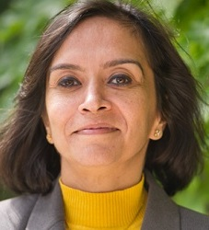
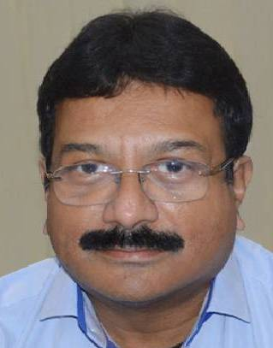
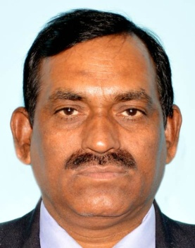
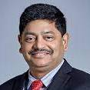
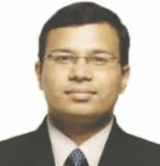
Supported by
Ministry of Coal
Government of India
Indian National Committee
World Mining Congress
SESSION II: ATMANIRBHARTA IN STEEL MAKING FOR COAL
Session Chairs
Speakers
RUCHIKA CHAUDHRY GOVIL
Additional Secretary
MINISTRY OF STEEL
SAMIRAN DATTA
CMD
BCCL.
ARVIND K SINGH
Director
SAIL
D B SUNDARA RAMAM
VP - Raw Materials
TATA STEEL
NAVEEN AHLAWAT
Head- Coal Gasification
Projects, JSPL
1st National Coal Conclave &
Exhibition
17 OCTOBER 2022, HOTEL TAJ PALACE , NEW DELHI

Slide 7
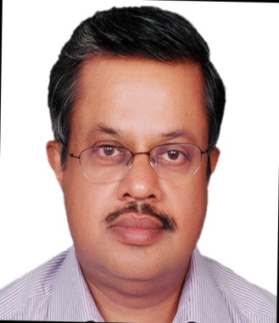
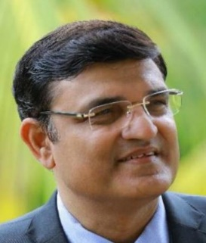
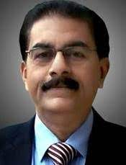
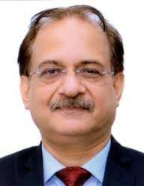
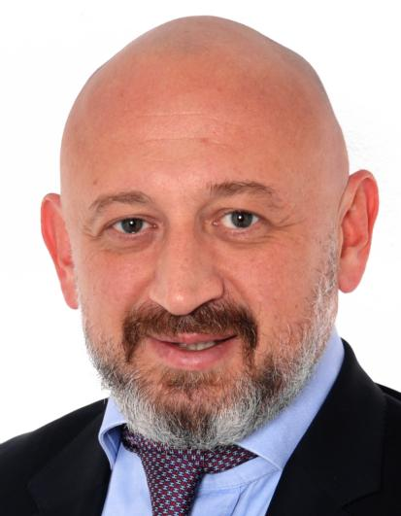
Supported by
Ministry of Coal
Government of India
Indian National Committee
World Mining Congress
SESSION III: TECHNOLOGY & SUSTAINABILITY
Session Chairs
Speakers
CHANDRA PRAKASH GOYAL
DG - Forest & Spl. Secretary
MoEF&CC
RAKESH KUMAR
CMD
NLC INDIA LTD.
R R MISHRA
Sr. Energy Consultant
WORLD BANK
SUNIL CHATURVEDI
Group Chairman
GAINWELL
VADIM PEVZNER
Director of Services
UZTM-KARTEX
1st National Coal Conclave &
Exhibition
17 OCTOBER 2022, HOTEL TAJ PALACE , NEW DELHI

Slide 8
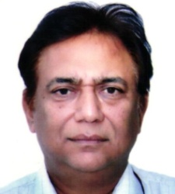
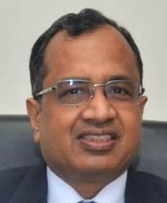
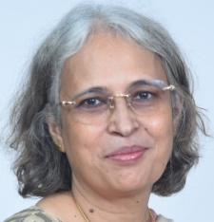
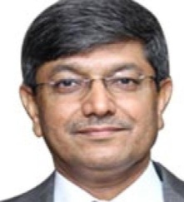
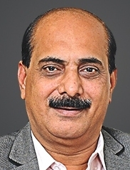
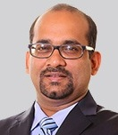
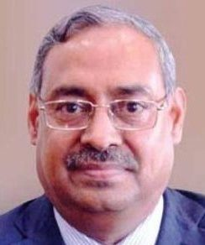
Supported by
Ministry of Coal
Government of India
Indian National Committee
World Mining Congress
CEO SESSION
DR. ANIL KUMAR JAIN
Secretary
Ministry of Coal
PRAMOD AGRAWAL
Chairman
COAL INDIA
SOMA MONDAL
Chairman
SAIL
GURDEEP SINGH
CMD
NTPC
SUNIL DUGGAL
Group CEO
VEDANTA
VINAY PRAKASH
CEO, Natural Resource
ADANI GROUP
ANIL K JHA
Chairman
JINDAL POWER
1st National Coal Conclave &
Exhibition
17 OCTOBER 2022, HOTEL TAJ PALACE , NEW DELHI

Slide 9
1st National Coal Conclave & Exhibition
17 OCTOBER 2022 , HOTEL TAJ PALACE , NEW DELHI
Platinum Sponsor
Silver Sponsor
Bronze Sponsor

Slide 10
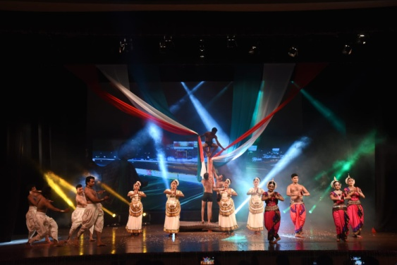
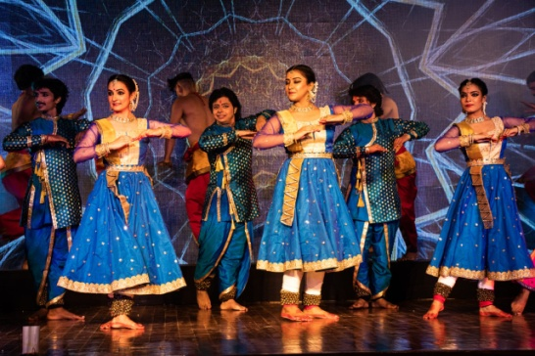
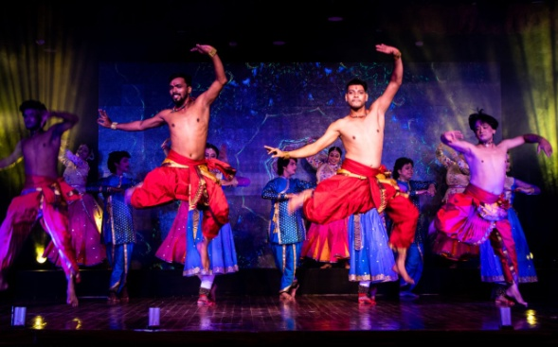
Supported by
Indian National Committee
World Mining Congress
Ministry of Coal
Government of India
THE COLOURS OF INDIA (A Cultural Evening)
Presented by
URVASHI DANCE MUSIC ART & CULTURAL SOCIETY
7.00 PM, DURBAR HALL
1st National Coal Conclave &
Exhibition
17 OCTOBER 2022, HOTEL TAJ PALACE , NEW DELHI
For registration, contact:
E:inc.wmc@gmail.com
W: www.wmc-inc.org

